Slide 1
Power Profile
Eddie Choo
Professional Coordinator

Slide 2
My Background:
Business Degree (Major in Accounting)
My Wife’s Background:
Science Degree (Major in Chemistry)
Current Occupation:
Businessman
(Executive Search Firm and Air Purifier Business)

Slide 3
KEY TO OUR SUCCESS
In MA,
we can only earn as
much as
we have learned!
Eddie Choo

Slide 4
Conventions / Seminars
Since we started, my wife and I have attended respectively:
2 x Miami World Conferences
1 x Greensboro International Convention
4 x Taiwan Conventions
All Singapore English and Chinese Local Seminars
All Singapore Product Symposiums
All Singapore Annual & Leadership School Conventions

Slide 5
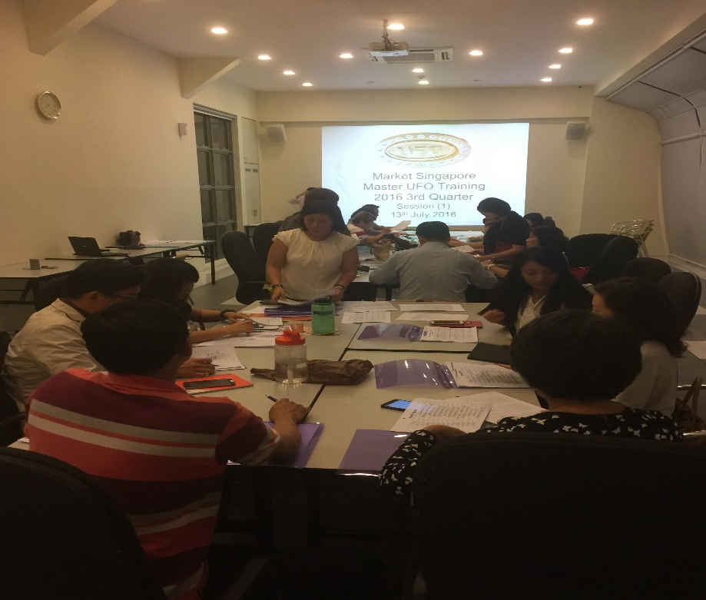
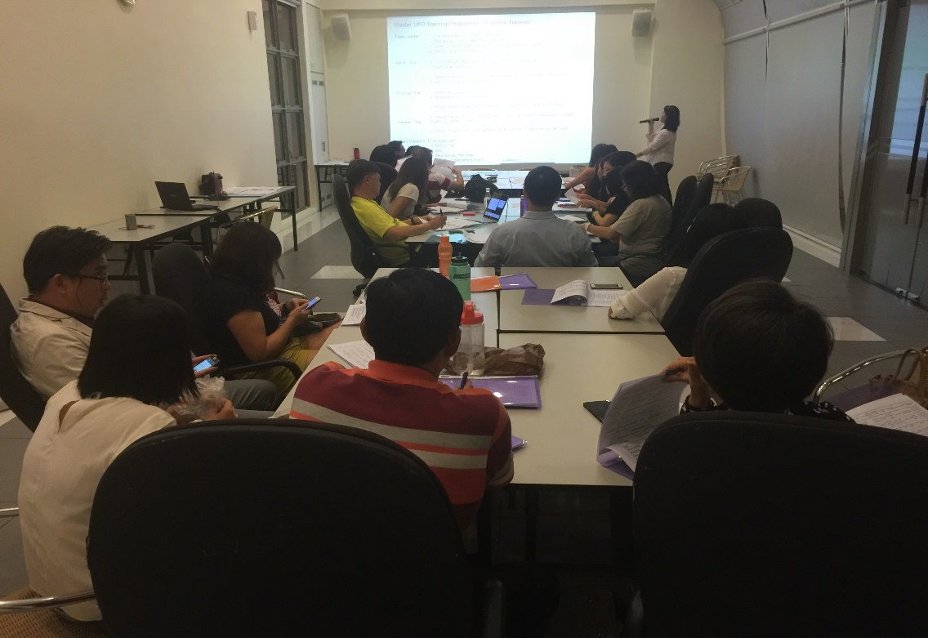
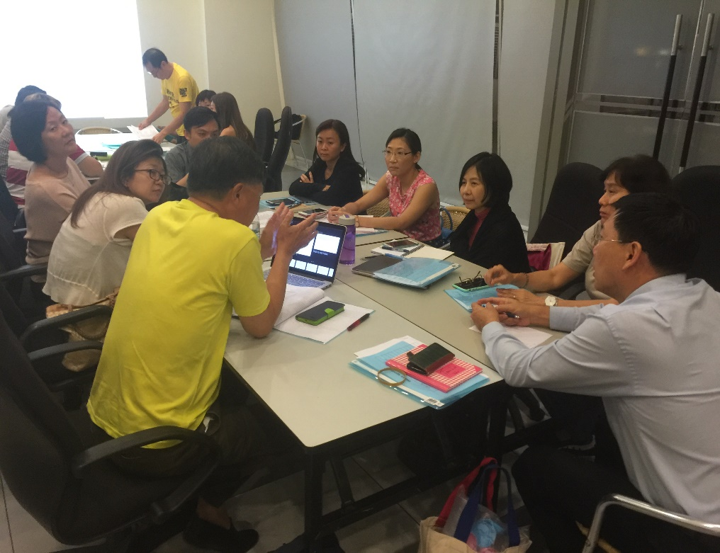
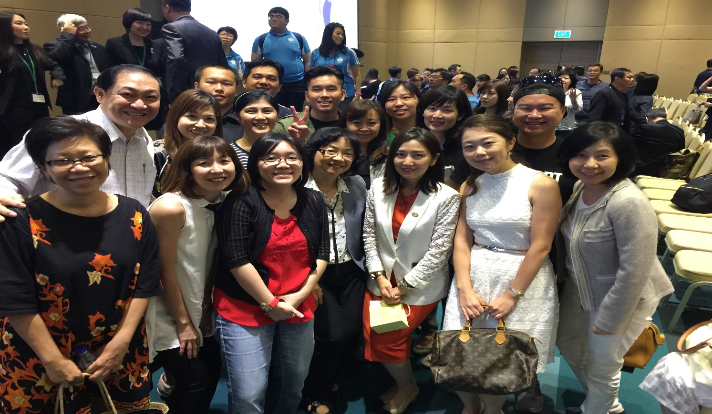
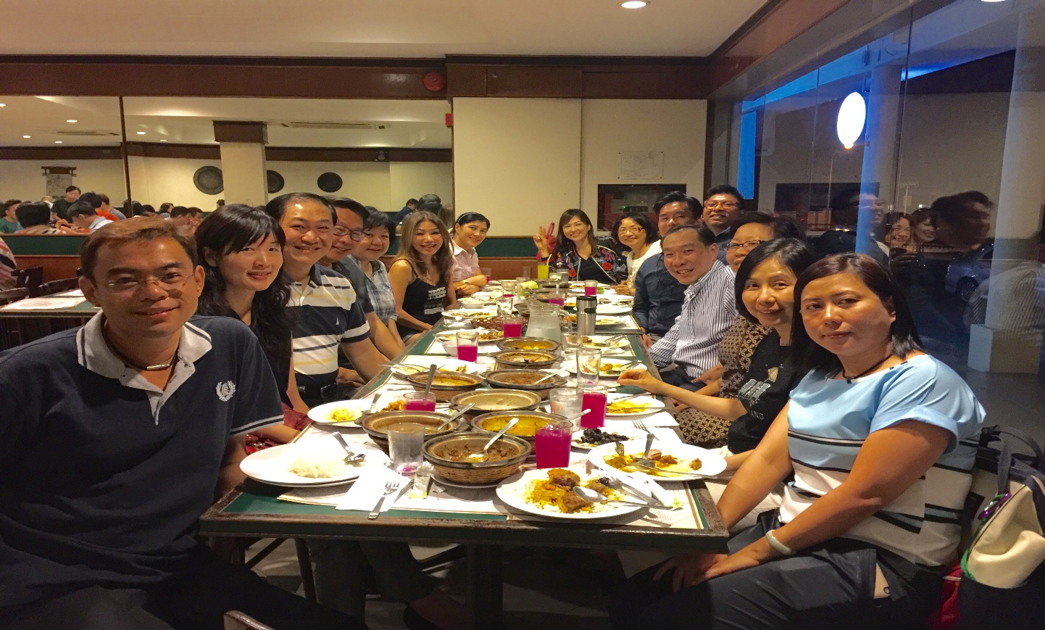
Our Top Team – We love our Team!!

Slide 6
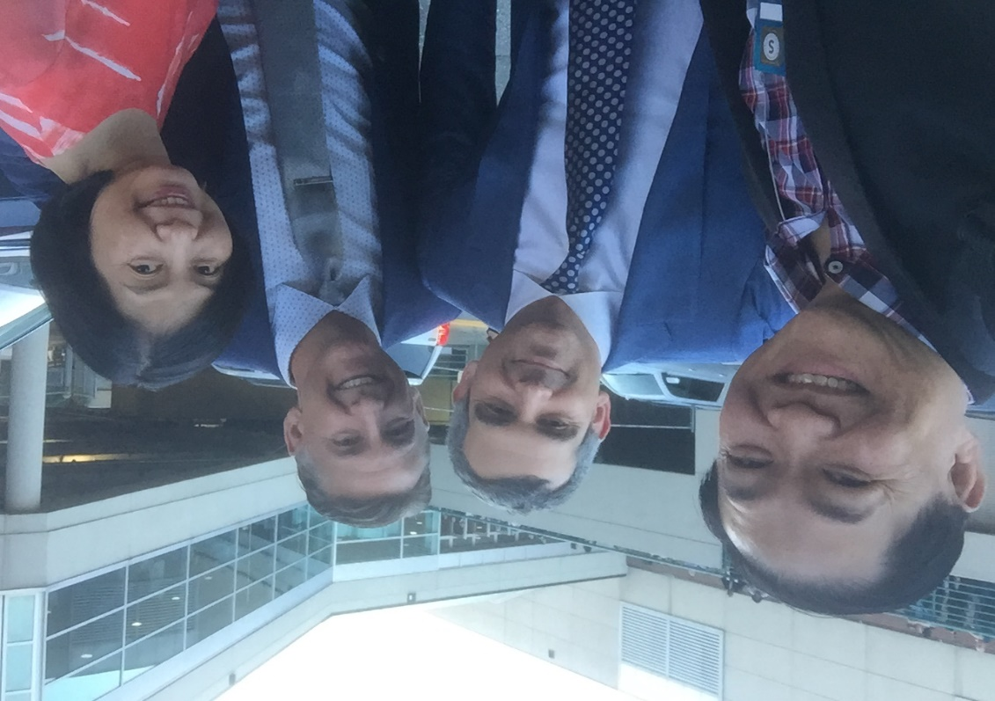
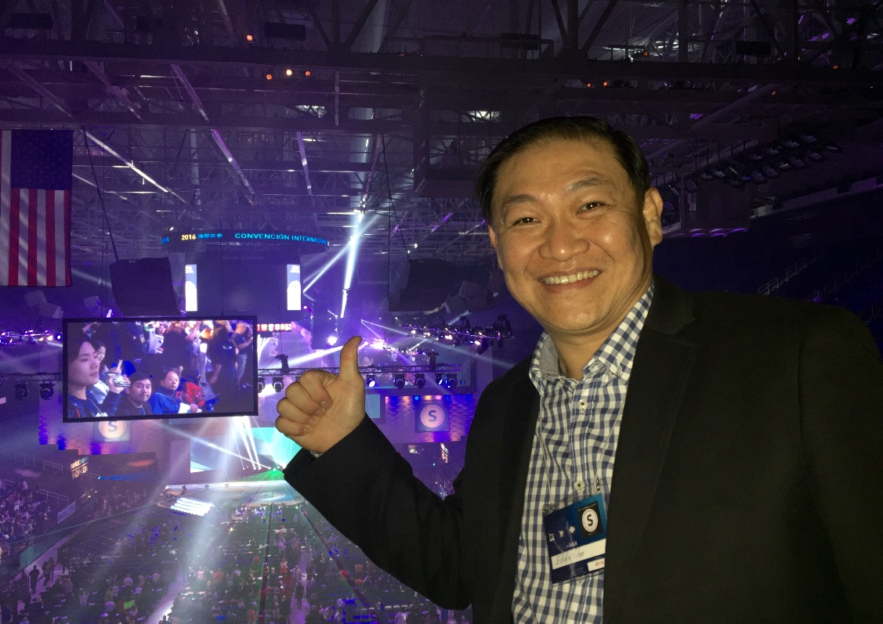
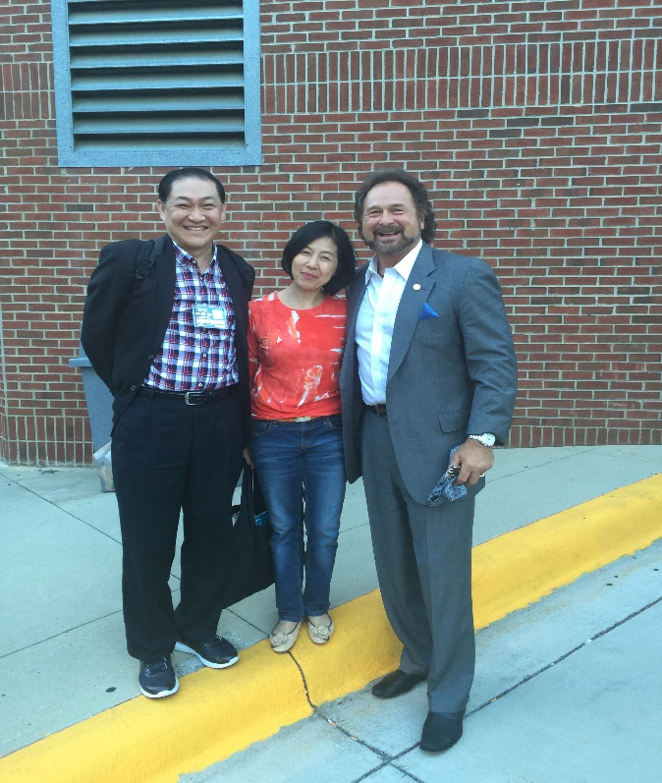
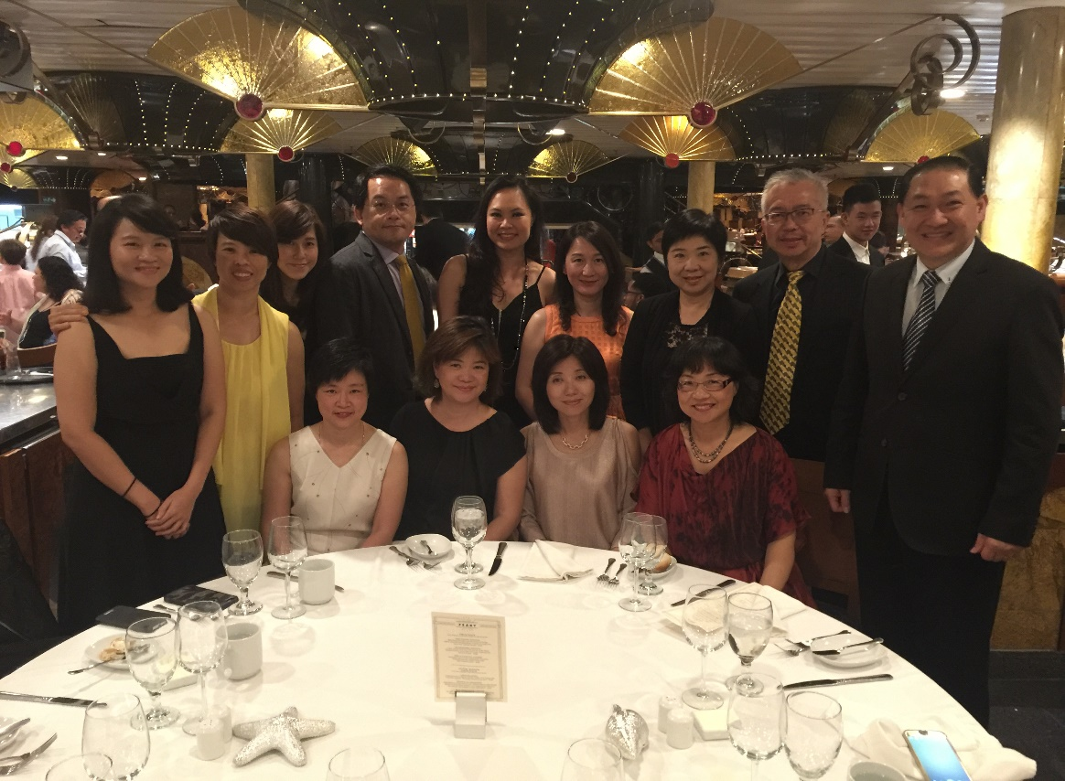
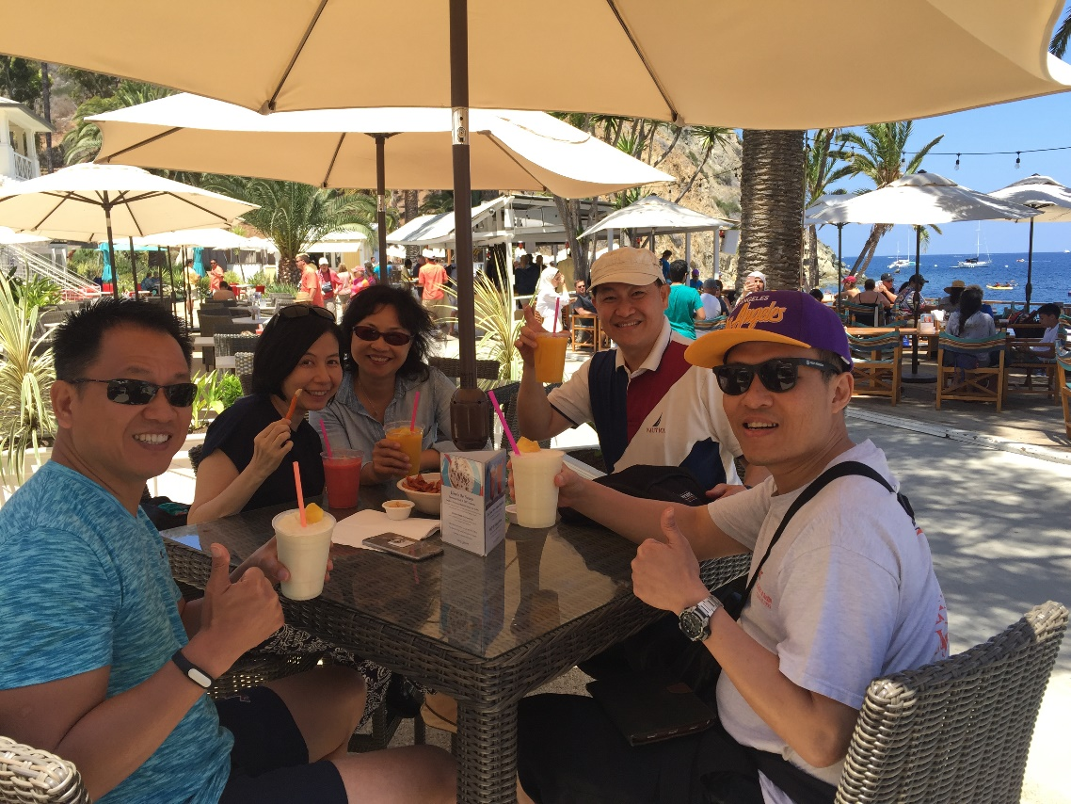
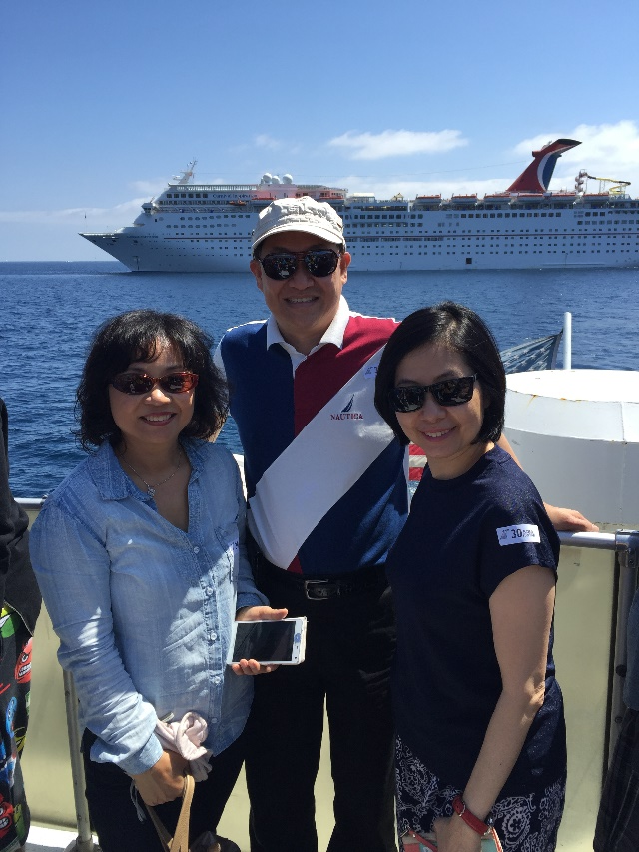
August 2016 International Convention - Greensboro

